Slide 1
M2EU: Meta Learning for Cold-start Recommendation via Enhancing User Preference Estimation
method
task
method
Source : SIGIR ‘23
Speaker : yang-YI, LIN
Advisor : Jia-Ling, Koh
Date : 2023/10/31

Slide 2
Outline
Introduction
Method
Experiment
Conclusion

Slide 3
Recommendation

Slide 4
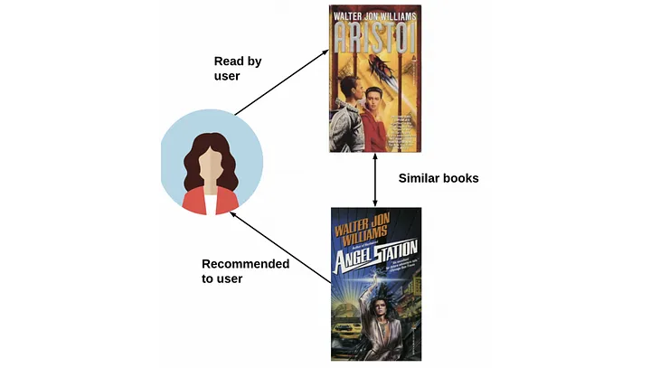
Content-based Filtering

Slide 5
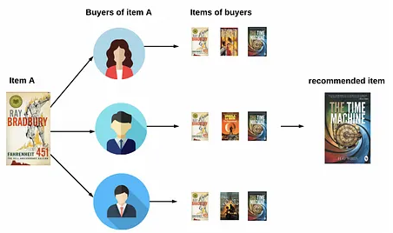
Collaborative Filtering
User-based
Item-based

Slide 6
Matrix Factorization

Slide 7
Cold-Start Recommendation

Slide 8
Cold-Start Recommendation

Slide 9
Recommendation
test
train

Slide 10
Meta-Learning
train
test
test
task1
task2
task3
train

Slide 11
Outline
Introduction
Method
Experiment
Conclusion

Slide 12
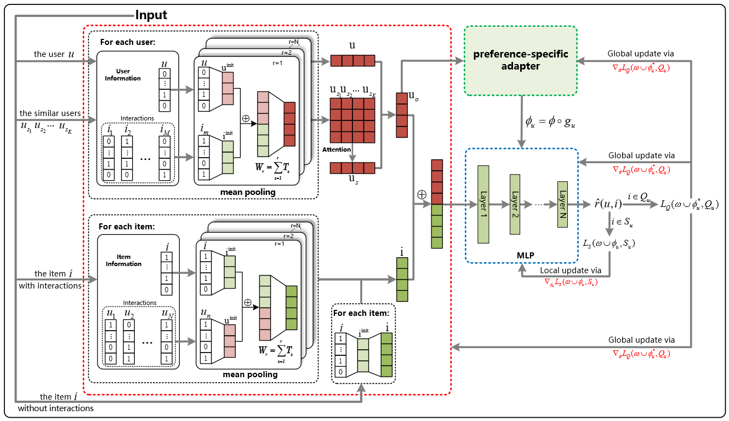
Method —M2EU
user and item representation builders
preference-specific adapter
prediction module

Slide 13
User and Item Representation Builders
identifying similar users
HD(．$,$．)：Hamming Distance
$a_{u}$：feature vectors N：number of user features
ABS(．) ： Absolute Value
$r$：rating scores L：number of the items rated

Slide 14
User and Item Representation Builders
Hamming Distance
$$a_{u1}$$
1 | 0 | 0 | 0 | 0 | 1 | 0 | 0 | 1 | …
$$a_{u2}$$
0 | 1 | 0 | 0 | 0 | 0 | 1 | 0 | 1 | …
gender
age

Slide 15
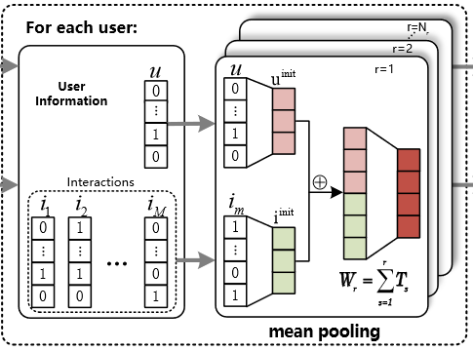
User and Item Representation Builders
concat N features of user
incorporates user-item interactions
a weight sharing mechanism
( , )

Slide 16
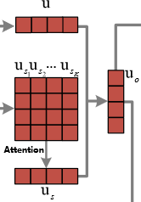
User and Item Representation Builders
use attention to aggregate top 𝐾 similar users embeddings
$var：$variances
Incorporates user embedding $u$ and aggregation $u_{s}$
or

Slide 17
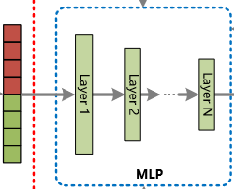
Prediction Module
predict the rating score

Slide 18
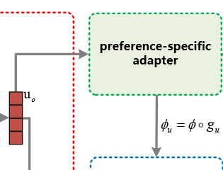
Preference-Specific Adapter
$g_{u}$ adjust the prediction module parameters 𝜙
◦：the element-wise product

Slide 19
Loss Function
loss on the support set
loss on the query set
$u_{o}^{′}$ generated by randomly dropping some user-item interactions and similar users
$i^{′}$ generated only by the item content.

Slide 20
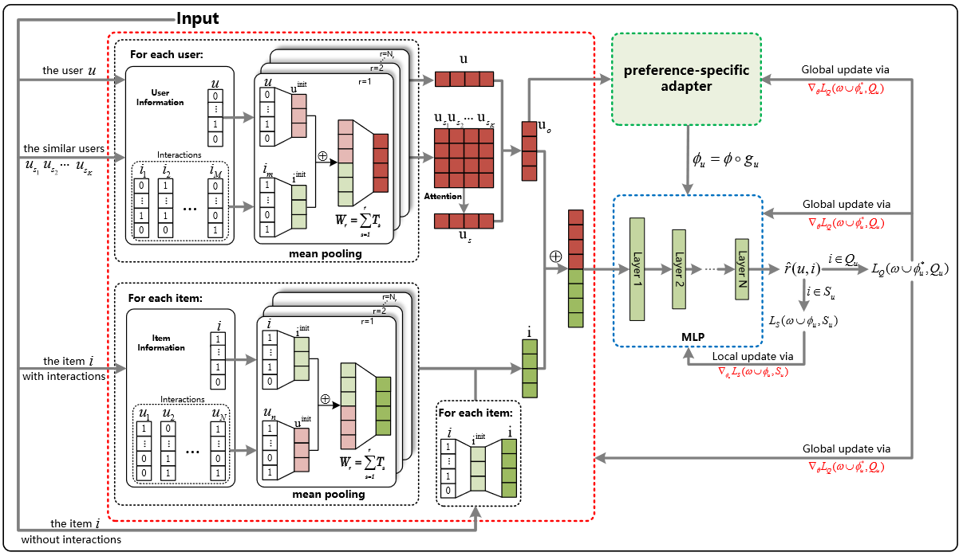
Meta Optimization

Slide 21
Dropout
In meta-training,
user representation
randomly drop out some interactions and similar users in tasks
item representation
randomly select some items and drop out all the interactions of the selected items

Slide 22
Incremental Learning
model tends to learn the new task batch
forgetting the previously learned knowledge
solution

Slide 23
Outline
Introduction
Method
Experiment
Conclusion

Slide 24
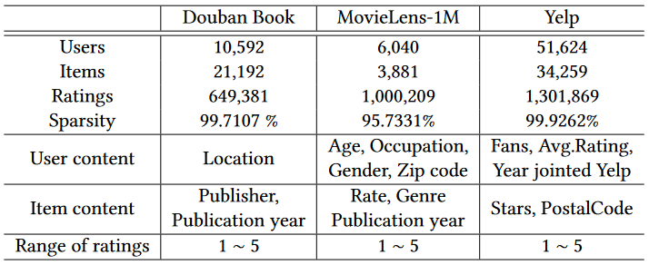
Data Set

Slide 25
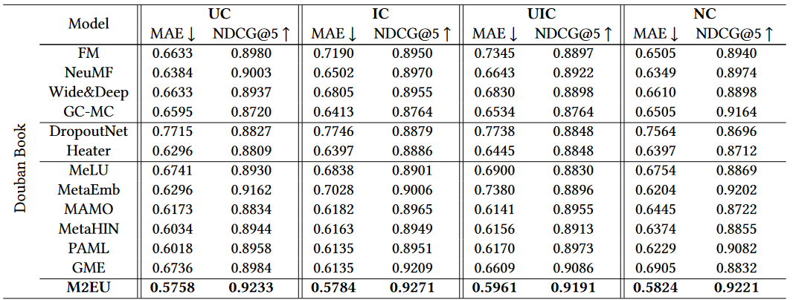
Experiment

Slide 26
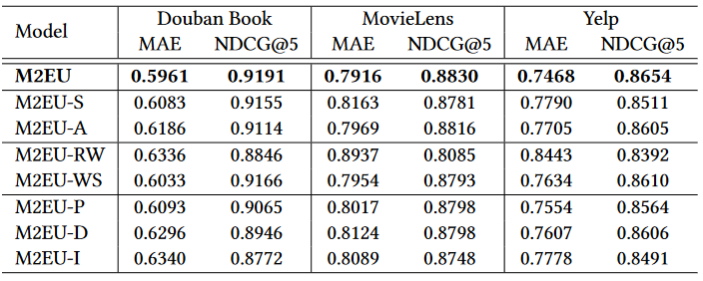
Ablation Study
“S”：top 𝐾 similar users, “A”：attention mechanism
“RW”：weight matrices at the rating level, “WS”：weight sharing
“P”：preference-specific adapter, “D”：dropout
“I”： incremental learning

Slide 27
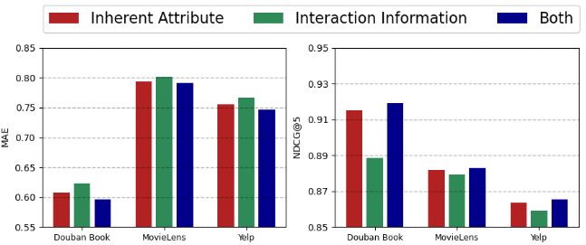
Ablation Study

Slide 28
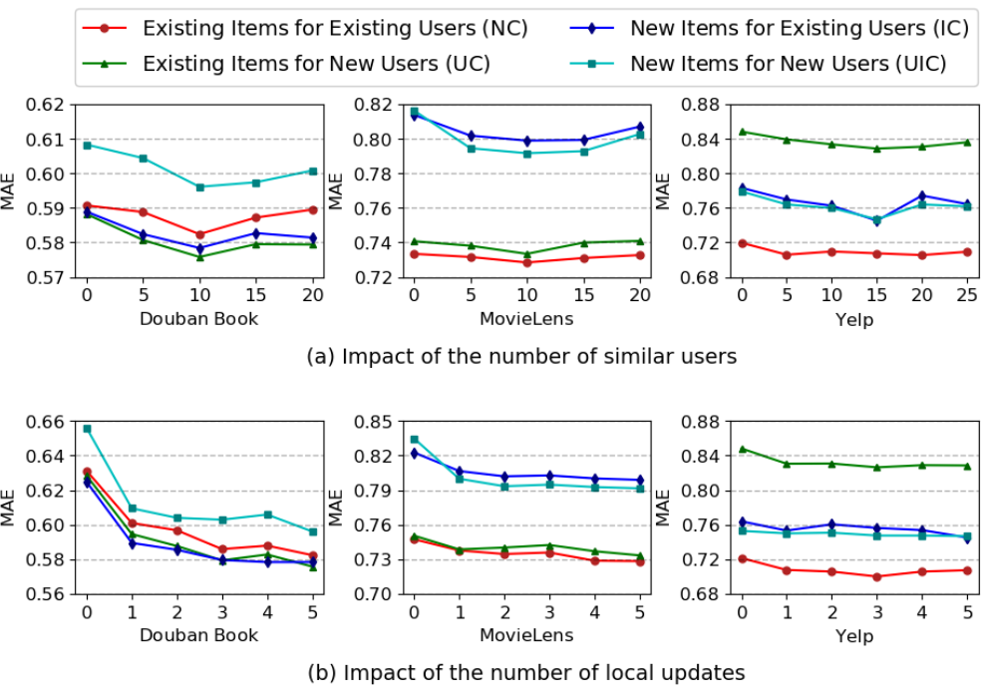
Parameter Analysis

Slide 29
Conclusion
a novel meta-learning approach called M2EU to alleviate the cold-start problem
use the information of the most similar users to enrich user representation
introduce a weight-sharing mechanism to avoid learning the parameters inadequately
an incremental learning scheme and dropout in meta-training.
a preference-specific adapter for prediction

